Slide 1
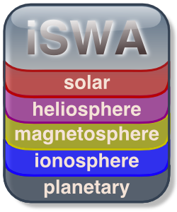

Integrated Space
Weather Analysis
System
Science and Engineering Student Internship
Jon Conti-Vock, NASA Goddard Space Flight Center
Space Weather Laboratory/Community Coordinated Modeling Center
http://iswa.gsfc.nasa.gov http://ccmc.gsfc.nasa.gov
Special thanks to Marlo Maddox and David Berrios

Slide 2
Overview
Background / Purpose
Objective
Quick Demo
Design
Conclusion / Extras

Slide 3
Problems
Space weather resources are diverse and scattered
Need for easily accessible, understandable and useful data products
Need for accurate real time nowcasting/forecasting of the space environment
Need for historical space weather impact analysis
Background
Objective
Demo
Design
Conclusion

Slide 4
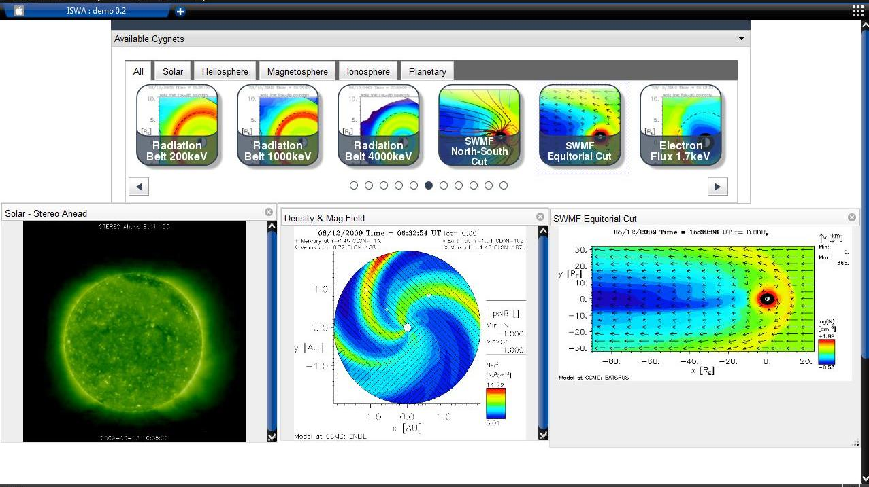
iSWA
Background
Objective
Demo
Design
Conclusion

Slide 5
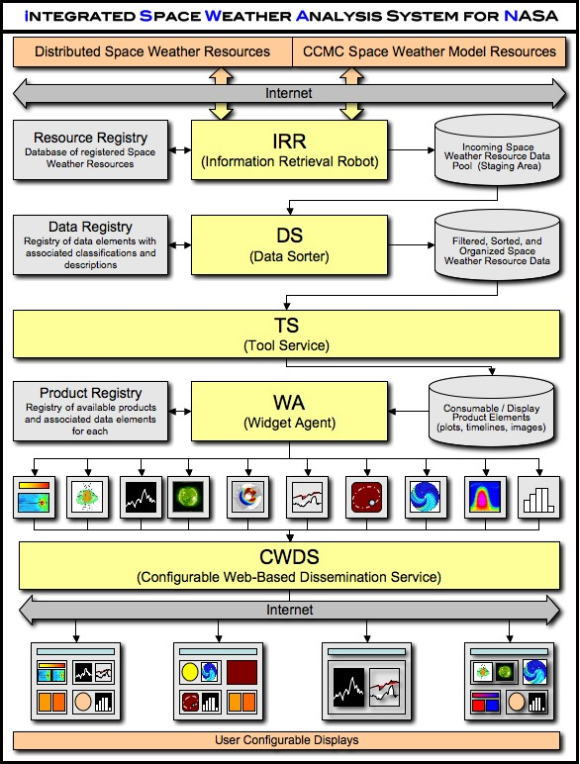

Background
Objective
Demo
Design
Conclusion

Slide 6
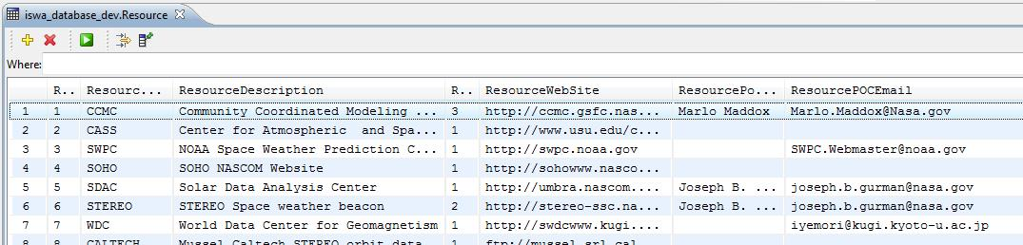
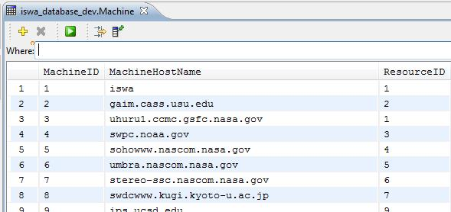
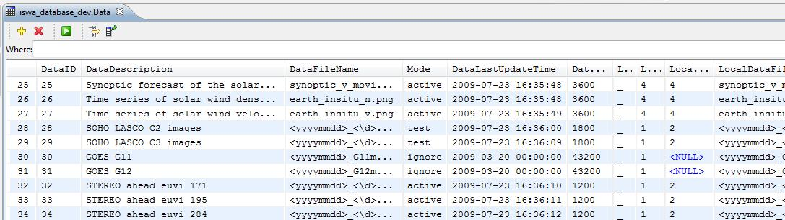
Background
Objective
Demo
Design
Conclusion

Slide 7
Working with the Database
  Install development environment and necessary plug-ins
  Create necessary connections
  Switch between a browser and the dev environment while data hunting
  Manually adding all data fields in tables
  Tedious
Background
Objective
Demo
Design
Conclusion

Slide 8
Great Idea
  “We could use an Intern.”
Background
Objective
Demo
Design
Conclusion

Slide 9
Goal
  Functional
  User-friendly
  Intuitive
  Easy on the eyes
Background
Objective
Demo
Design
Conclusion

Slide 10
My Project at a Glance
Background
Objective
Demo
Design
Conclusion

Slide 11
Utilities
  Working environment:
  Eclipse Ganymede Enterprise Edition
  Plug-ins: DB Viewer, CVS
  Frameworks/Toolkits
  Prototype
  Scriptaculous
  Dojo
  MySQL
  Java
  AJAX
  JSP
  Java Servlets
  Apache Tomcat
Background
Objective
Demo
Design
Conclusion

Slide 12
Overall Design
HTML
Asynchronous JavaScript
Java Servlets
Java
Background
Objective
Demo
Design
Conclusion

Slide 13
Conclusion
increased understanding of web-based processing
will have a functional product by the end of my internship
exposure to better programming design
experience working closely with a diverse group
Background
Objective
Demo
Design
Conclusion

Slide 14
Thank You
Questions?
Background
Objective
Demo
Design
Conclusion

